Slide 1


Greenwish Ltd Electric Vehicle Recommendation
Paul Boyle

Slide 2
The Brief
New fleet of electric sales rep cars for the UK
Choice backed up by data

Slide 3
The top 5
Cars selected based on electric range, charge speed and fast charge speed.
Mercedes EQS 450plus
Mercedes EQE 350plus
Tesla Model 3 Long Range Dual Motor
BMW i4 eDrive40
Tesla Model 3 Performance

Slide 4
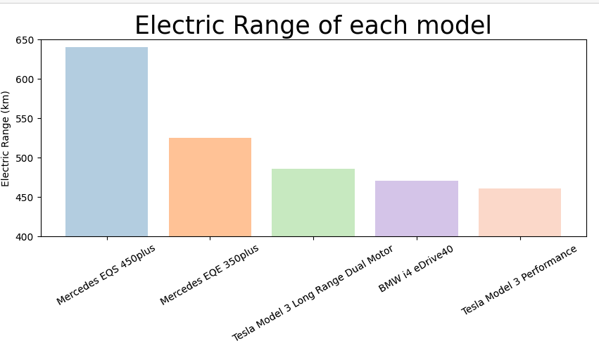
Clear to see that the Mercedes EQS 450plus has the longest range

Slide 5
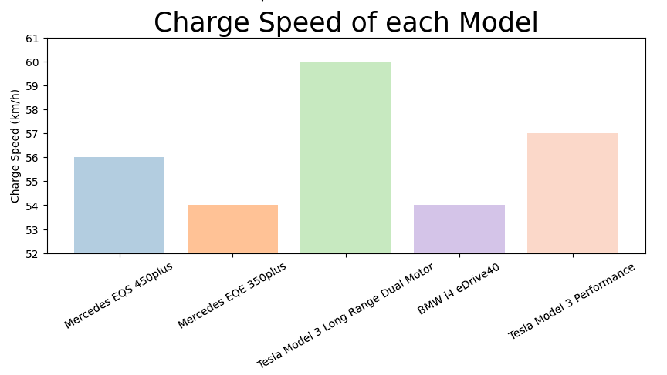
The Tesla Model 3 Long Range had the 3rd best range but has the best Charge Speed

Slide 6
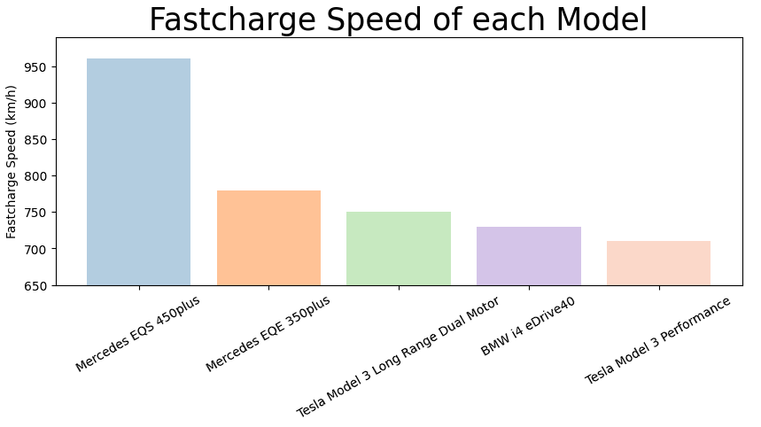
However the Fast charge speed of the Mercedes is much higher than its competitors

Slide 7
Final Recommendation: Mercedes EQS 450plus
Best range
Although the charge speed is slightly lower than some competitors the fast charge speed is much higher. If employees can access fast charge stations at the office or in service stations then down time while waiting for the vehicle to charge will be much lower resulting in more sales visits!

Slide 8
Further Questions
The data didn’t include price, so recommendations could change based on further information.
Some assumptions were made about the lack of a need for equipment.

Slide 9
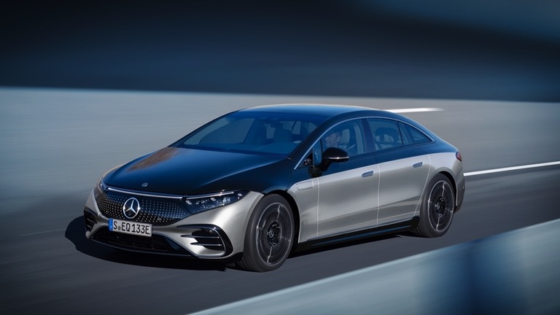
Any Questions?
Mercedes EQS 450plus

